Slide 1
Network’s Battery Monitoring
Dexpertize Virtual Company

Slide 2




Problems
Running out of battery without knowing
Increase internet downtime
Battery health is unknown
Notes:
Running out of battery without knowing
Increase internet down time
Battery health is unknown (identify the infection)

Slide 3




Solutions / Objectives
Notify when battery running low
Live monitor battery Voltage
Work within local-network
Threshold & Alert Interval Configuration can done on app/web

Slide 4
Output (Software)
Live monitor battery Voltage
Voltage Threshold for alert
Battery voltage histogram
Alert interval in second

Slide 5
Output (Software)
Alert / Notification when battery reach threshold

Slide 6
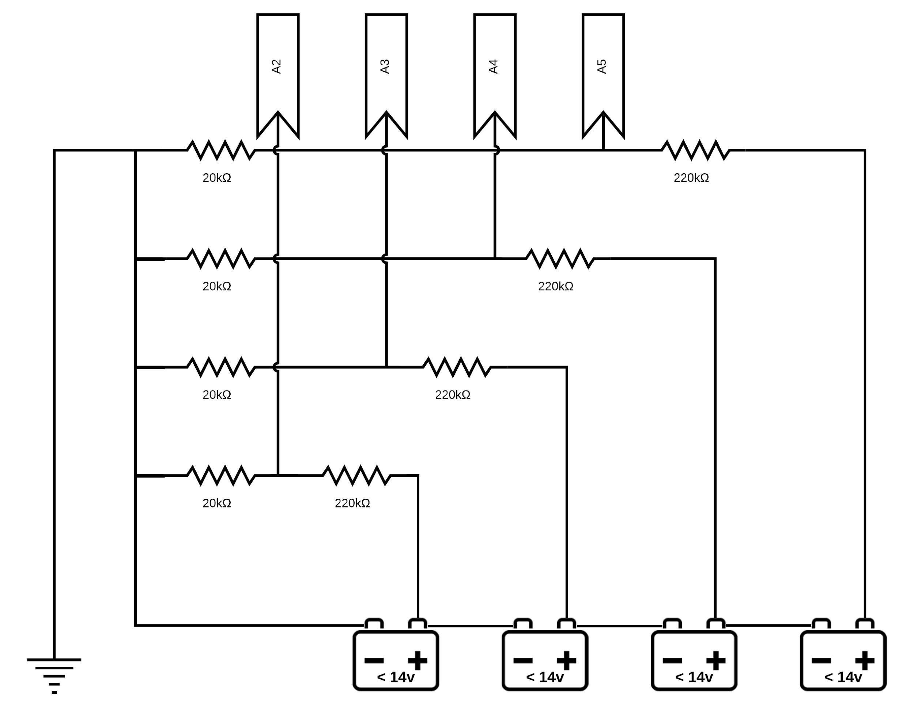
Output (Hardware)
3D Printed Case (KIT)
Voltage divider for Series of battery

Slide 7
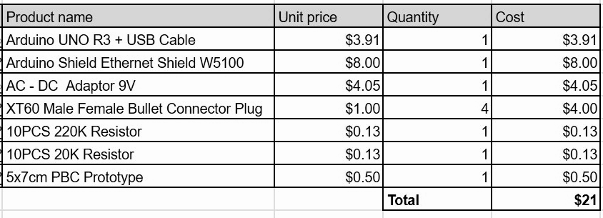
Cost of Production

Slide 8
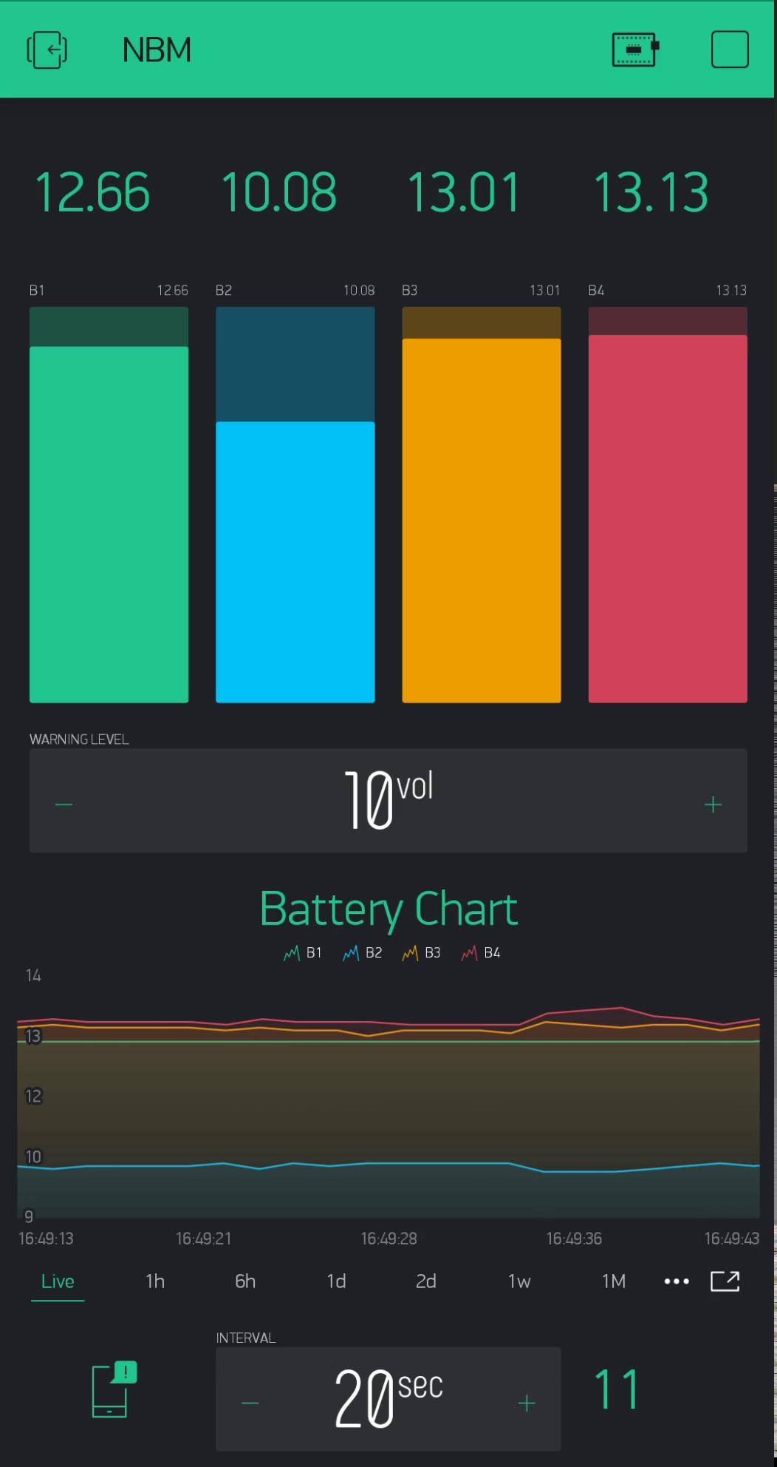
Demo

Slide 9
Mr.Takeshi Remark
This project is successfully closed and approve 10 KIT Point

